Slide 1
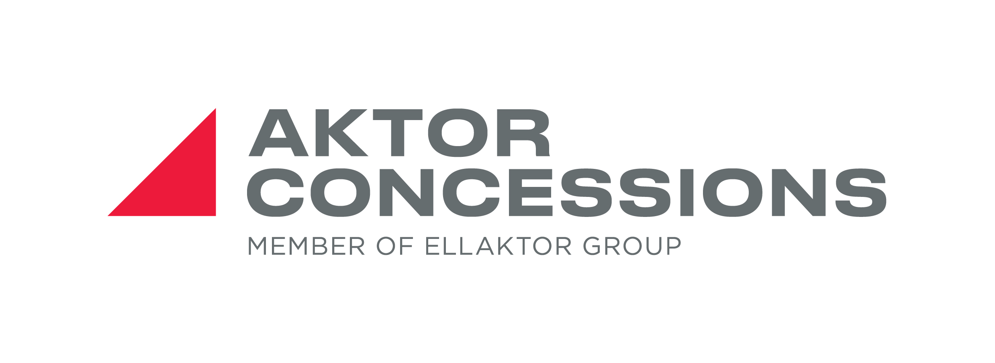
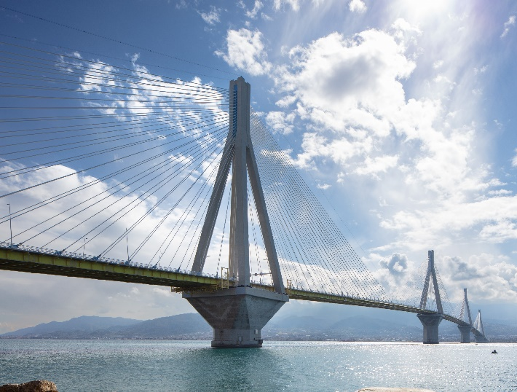
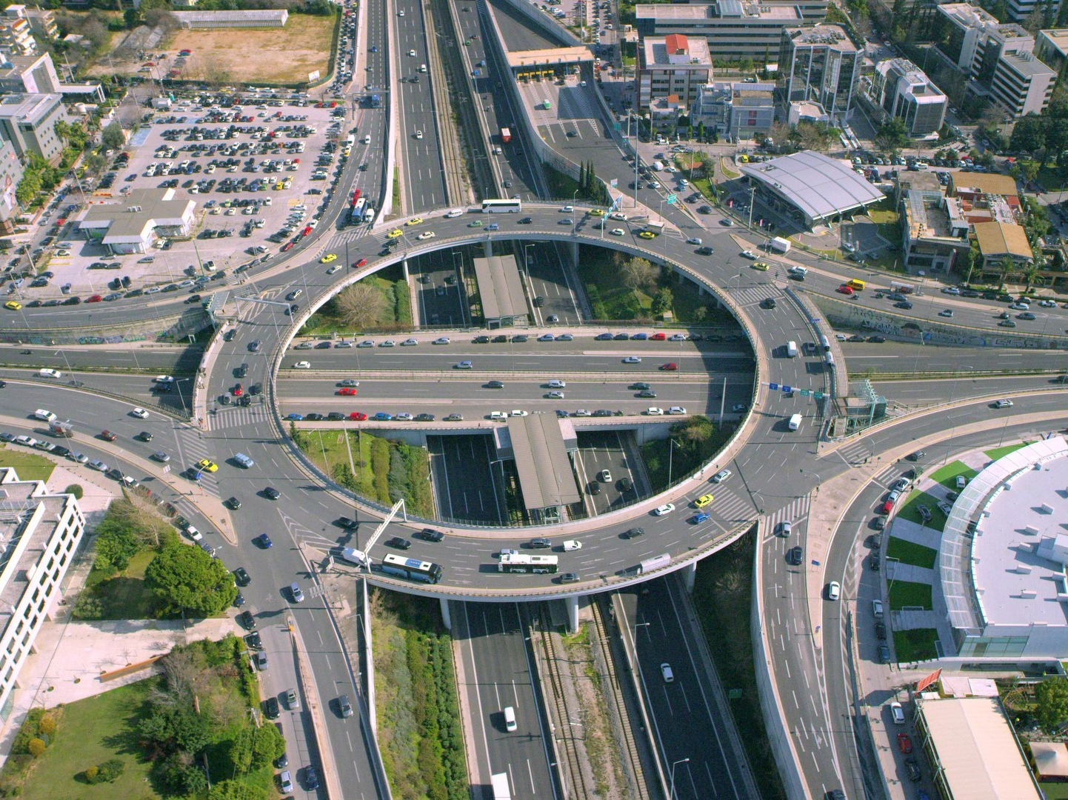
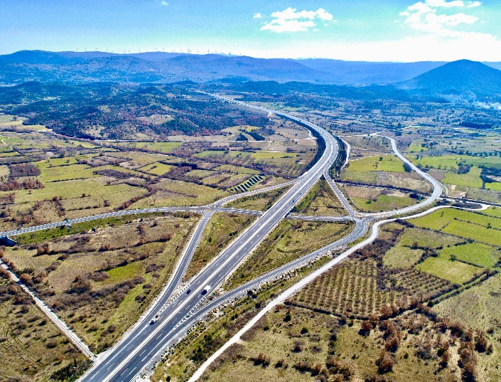
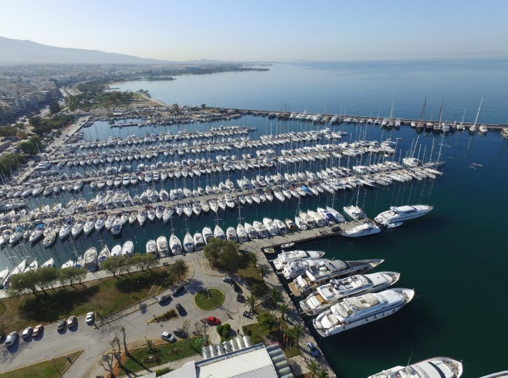

AKTOR CONCESSIONS
Corporate Presentation
June 2022

Slide 2
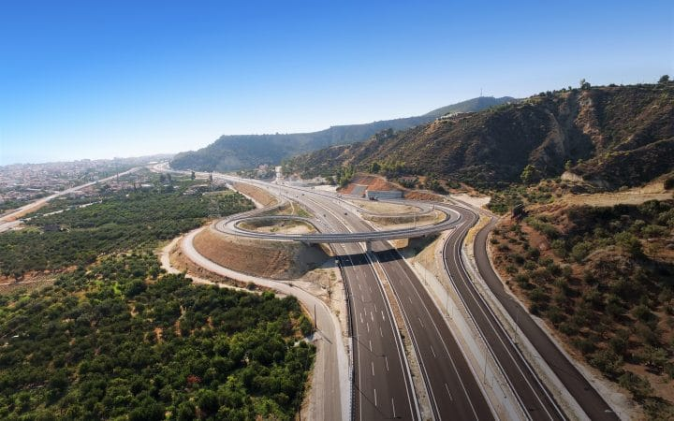
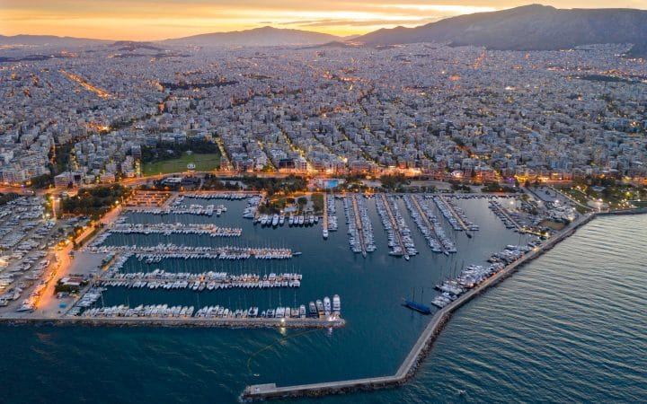

Contents.
1. Profile
2. Concessions at a glance
3. Participation Portfolio
4. Key Credit Highlights

Slide 3
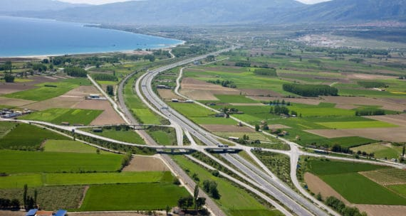
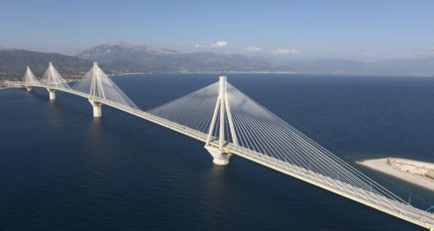
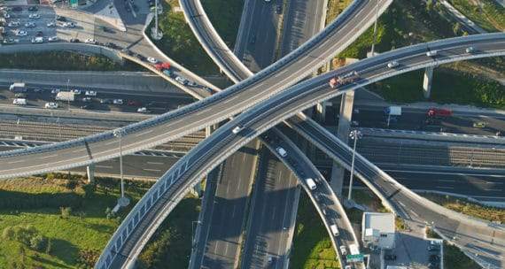

Profile.
AKTOR CONCESSIONS is the company, which literally opened the way for major concessions projects in Greece, undertaking relevant contracts already in the 1990s.
It is also the largest concessions company in Greece, covering the whole spectrum of concessions activities: financing, design, construction, maintenance and operation.
Possessing a majority stake in the Attiki Odos (65.8%) and Moreas (71.7%) Motorways, maintaining significant stakes (17-23%) in Olympia Odos, Aegean Motorway, as well as in Rion – Antirrion Bridge. AKTOR CONCESSIONS holds a leading position in Greece, while continuously expanding its portfolio of activities.
Beyond motorways, the company also participates in Car Park concessions, with a capacity of 5,639 parking spaces and the operation of another 2,195 parking spaces.
Moreover, AKTOR CONCESSIONS has signed a Concession Agreement for the right to use, operate, manage and develop the New Alimos Marina, largest marina in the Balkans, for a period of 40 years, with the right of mutual extension for another 10 years. The concession of the New Alimos Marina provides, among others, the right of developing the terrestrial zone, for a wide use of tourism, culture and recreation purposes, allowing for the realization of an integrated tourism investment with a total value of around € 100 million on the rapidly developing coastal front of the Greek capital, with multiple added value in both local and national level.

Slide 4







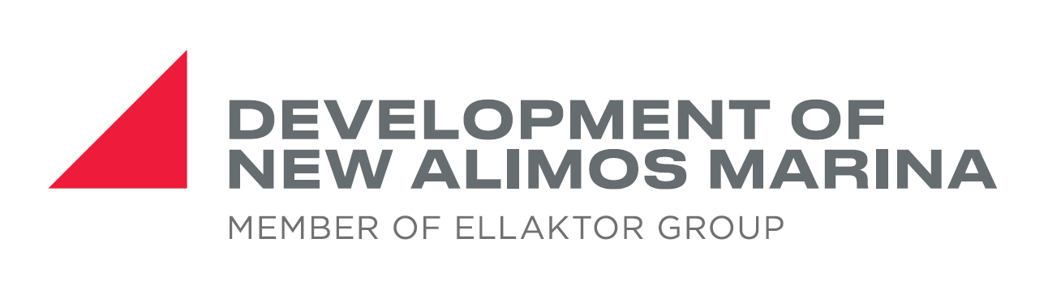









Concessions at a glance.
Unique concession portfolio providing a stable cash flow base
Pioneer in concessions with market leading portfolio
Market leader in Greece since pioneering the first PPP / concession contracts in ‘90s
Participates in concessions through Special Purpose Vehicles (SPVs) alongside strategic partners
Car Park Stations
5K Spaces
Critical infrastructure portfolio of mature concessions
Participation in 450K and c.785km of highways, including some of Greece’s most critical infrastructure
Critical nature of portfolio drives steady traffic volumes in the long term
Attiki Odos: Crucial Ring Road
Key Motorways connecting the largest cities in Greece
785km of highways under management
450,000 daily vehicle crossing on average
Long-term visibility with average remaining portfolio concession life of c.16 years
Strong cash flows from concessions driven by stable toll fees and traffic volumes with MAE loss of revenue insured from Concession Agreement
Long term stable cash flows
Experience across the whole range of concession activities with a strong track record and highly qualified personnel with expertise in niche technical areas provides a key competitive advantage
Significant contribution to the Group’s financial results
Proven track records
EBITDA
CASH FLOW

Slide 5
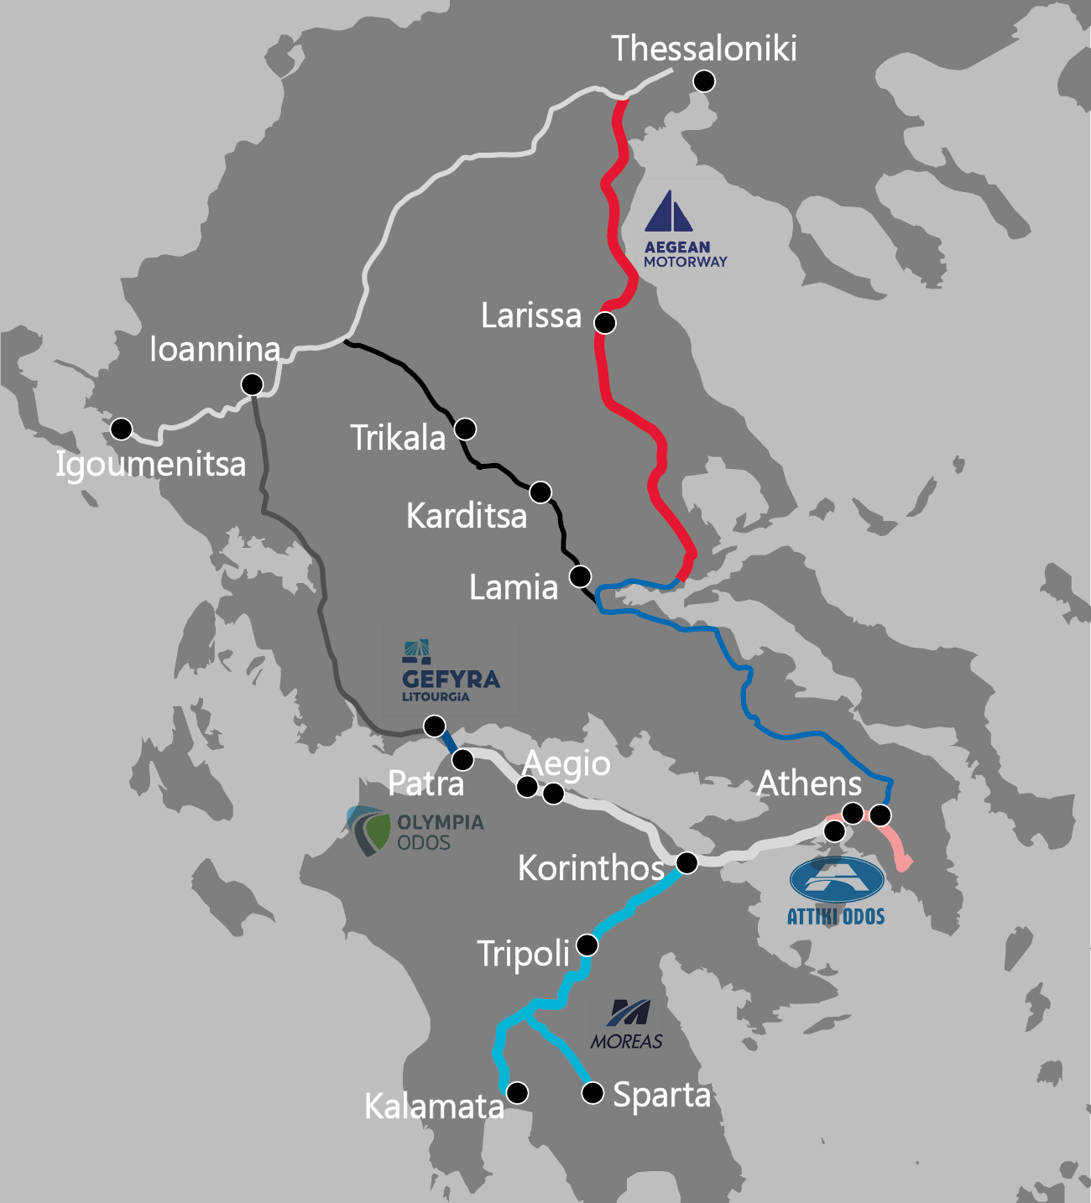
Concessions’ Participations Portfolio in Snapshot.
Operation of Motorways
Motor Services Stations &
Car Parking Stations
In full operation since 2017
Aegean Motorway
(Maliakos – Klidi Highway)
Gefyra
(Rion – Antirrion Bridge)
In full operation since Sept. 2017
Concession period ends in 2038
22.2%
In full operation since Aug. 2004
Concession period ends in 2039
22.0%
Car Park Stations
Olympia Odos
(Athens – Korinthos - Patra Highway)
In full operation
Attiki Odos
(Athens Ring Road)
In full operation since Sept. 2017
Concession period 2038 extended to 2044
65.7%
In full operation since Mar. 2001
Concession period ends in 2024
17.0%
Moreas
(Korinthos – Tripoli – Kalamata Highway)
New Alimos Marina
71.7%
100%
In full operation since Dec. 2016
Concession period ends in 2038
In operation since Jan. 2021
Concession period ends in 2060

Slide 6
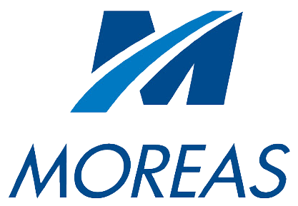
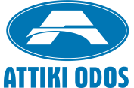




Portfolio Specifics.
Stake %
65.67%
22.00%
71.67%
22.22%
17.00%
100.00%
Concession Period
2001 – Sep 2024
2004 – Dec 2039
2008 – Mar 2038
2008 – Mar 2038
2008 – extended to
2044 + 74Km
length motorway
Jan 2021 – Dec 2060
Concession in Full Operation
January 2021 (partially)
March 2001
August 2004
December 2016
September 2017
September 2017
Investment
€ 1.310 ml
€ 839 ml
€ 1.0 bn
€ 1.6 bn
€ 2.1 bn + € 0.3 bn
€ 98.6 ml
Capacity
(ADT Pre-covid)
236,125 vehicles
10,965 vehicles
50,477 vehicles
67,630 vehicles
141,930 vehicles
1,100 berths
Operator
-
-
-
Connects the country’s two largest cities, Athens and Thessaloniki in just four hours and fifteen minutes
Road is of national strategic importance, linking the capital, Athens, with the Regions of Peloponnese, Western Greece and Epirus
Largest Marina in the Balkans with a Marina area of approx. 428,000m², offering berths for boats of varying sizes
Connects the outer beltways of the greater Athens metropolitan area
Modern motorway that brings the Peloponnese closer to Athens and the rest of Greece
World’s longest multi-span cable –stayed bridge in a high seismic area

Slide 7








Key Credit Highlights.
Well positioned to compete for the future challenges given our experience based Know-How
Vast Experience &
Know How in Concessions
Active involvement in Bid / Construction / Operation phases
Growing opportunities in the Greek Market
Invest in strategically selected assets - beneficial placements
Value add on Greenfield /
Brownfield projects
Disciplined approach
to efficiently manage risk vs return

